Slide 1
Social Engineering
Saif Ansari

Slide 2
What is social engineering
Manipulating people into divulging confidential information or performing malicious actions.
Attacker uses human interaction to get or compromise information
Attacker my appear unassuming or respectable
Pretend to be a new employee, repair man, etc.
May even offer confidential details or credentials to prove his/legitimacy
By asking questions, the attacker is able to gather enough information to infiltrate a company’s network
May attempt to get information from many sources

Slide 3
Why Social engineering
It is often easier to trick someone into giving you their information than hacking them
Systems can be secure, but the users may not be
Cheap and easy
It is not inherently illegal
Obtaining personal information.
Gaining unauthorized access.
Circumventing established procedures.
Because they can.

Slide 4
Type of Social Engineering
Pretexting
Quid Pro Quo
Baiting
Piggybacking
Shoulder Surfing
Phishing

Slide 5
Pretexting
Situation is fabricated
Research done to find information on the victim
Any public information available: yellow pages, professional information, public web pages, etc.
Personal and professional relationships compromised through association
Impersonation of authority is a common strategy
Ex. IRS scam with threats of consequences

Slide 6
Quid Pro Quo
This for that
IT assistance at a random company
Offer to help fix the issue
Have the victim follow instructions
Credentials required for fix

Slide 7
Baiting
Can depend on user’s greed/necessity
Real world Trojan horse
Attacker gives access to either physical media, or a file on the web (software, books, movies, etc.)
Attacker puts a legitimate looking label on the file or physical media (ex. Earnings Report)
Access to file or media silently installs to malware

Slide 8
Piggybacking
Person unauthorized to access a specific place is given access through an authorized but unaware person
Ex. Holding the door open for someone else
“I forgot my Entrance card, and I am super late”

Slide 9
Shoulder Surfing
Common occurrence in public places such as coffee shops
Observation of a person’s private information
Browsing habits can also be valuable

Slide 10
Phishing
Obtaining information through fraudulent means
Email pretending to be a legitimate entity
Usually involves information requests or threats of consequence if not provided with details
Also done through click-baiting
Spear-phishing

Slide 11
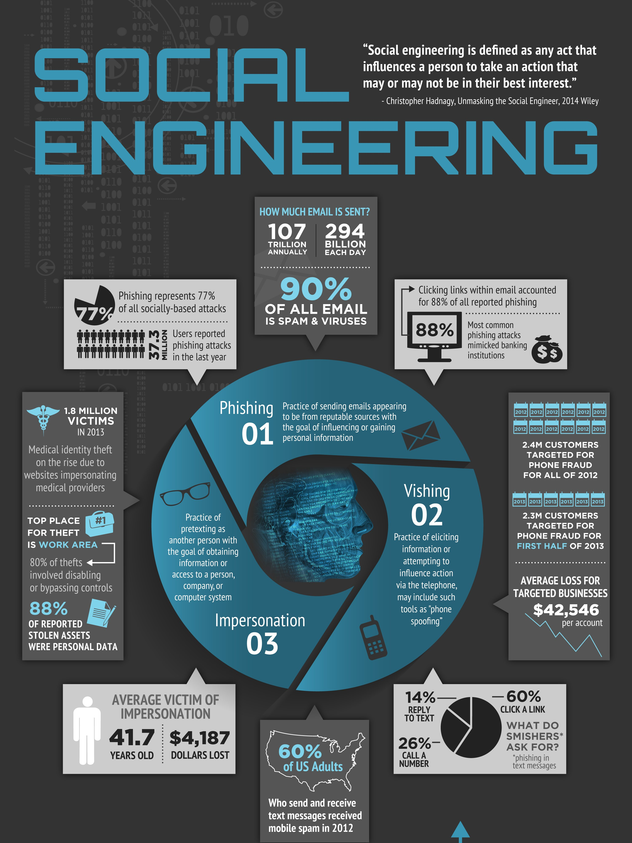

Slide 12
DEMO – Mass Mailer Attack

Slide 13
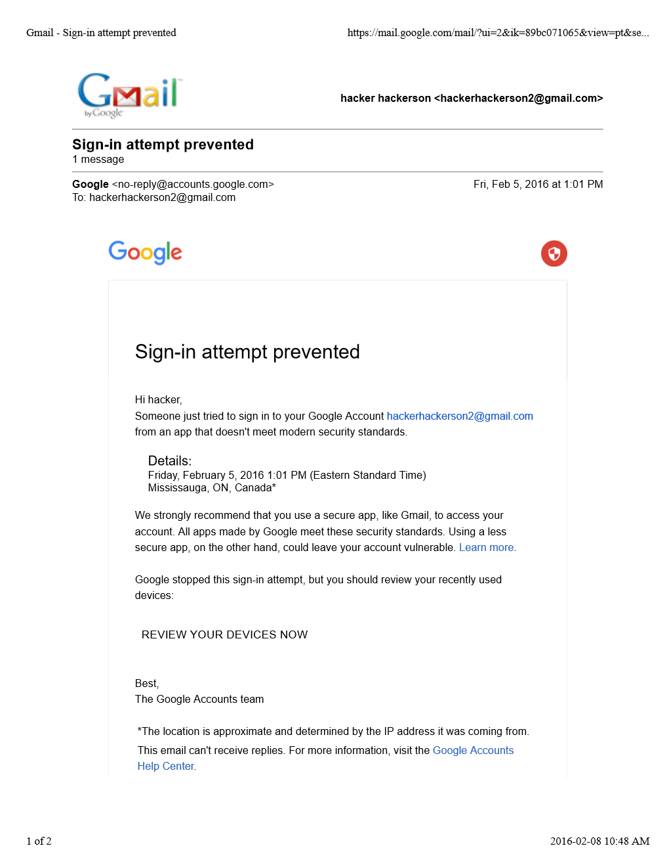

Slide 14
Examples of famous social engineering
419 [phishing]
Dell data breach (Led to calls from people pretending to be IT) [pretexting]
Ubiquiti Networks $39 million attack (CEO scam)
Barclays “KVM Heist”
DEFCON – Social Engineering Challenge – Walmart

Slide 15
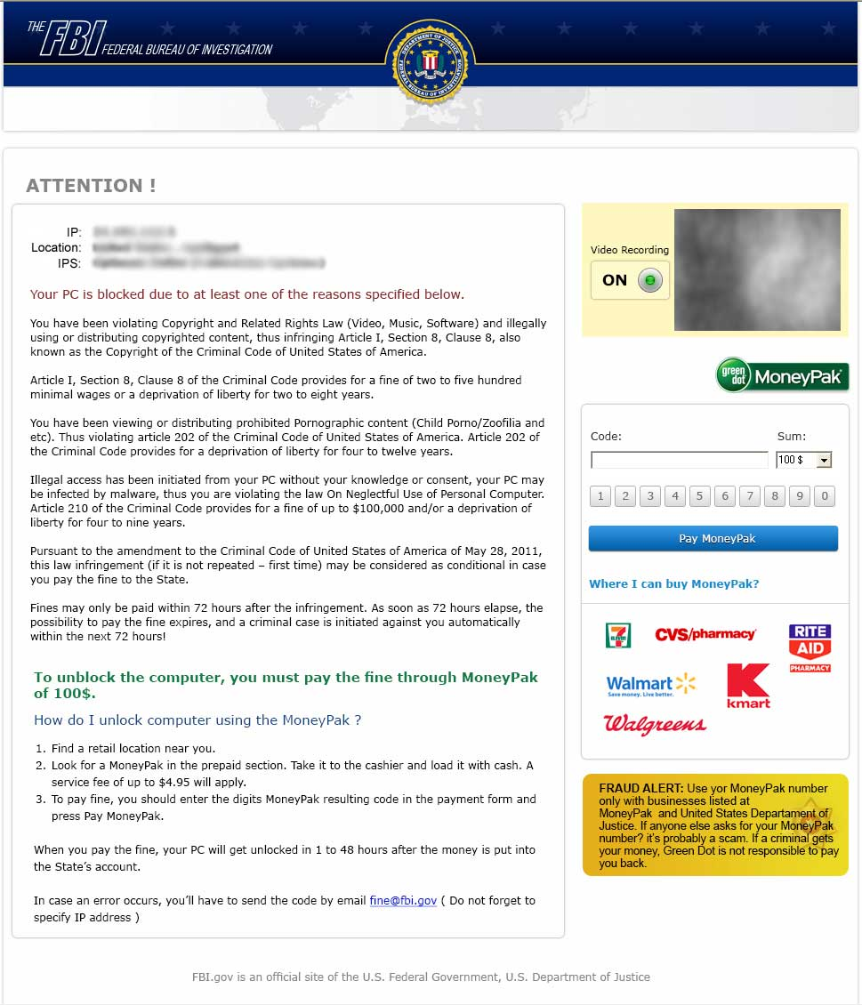

Slide 16
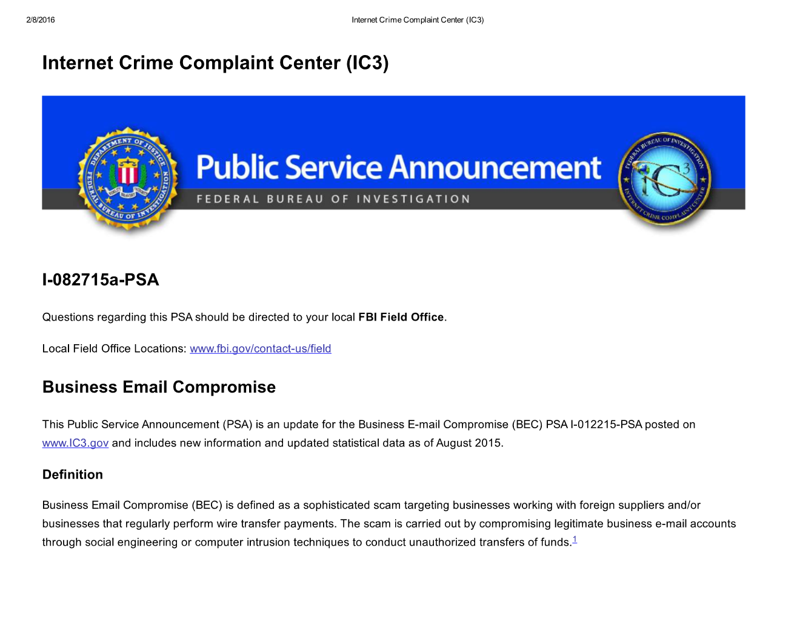
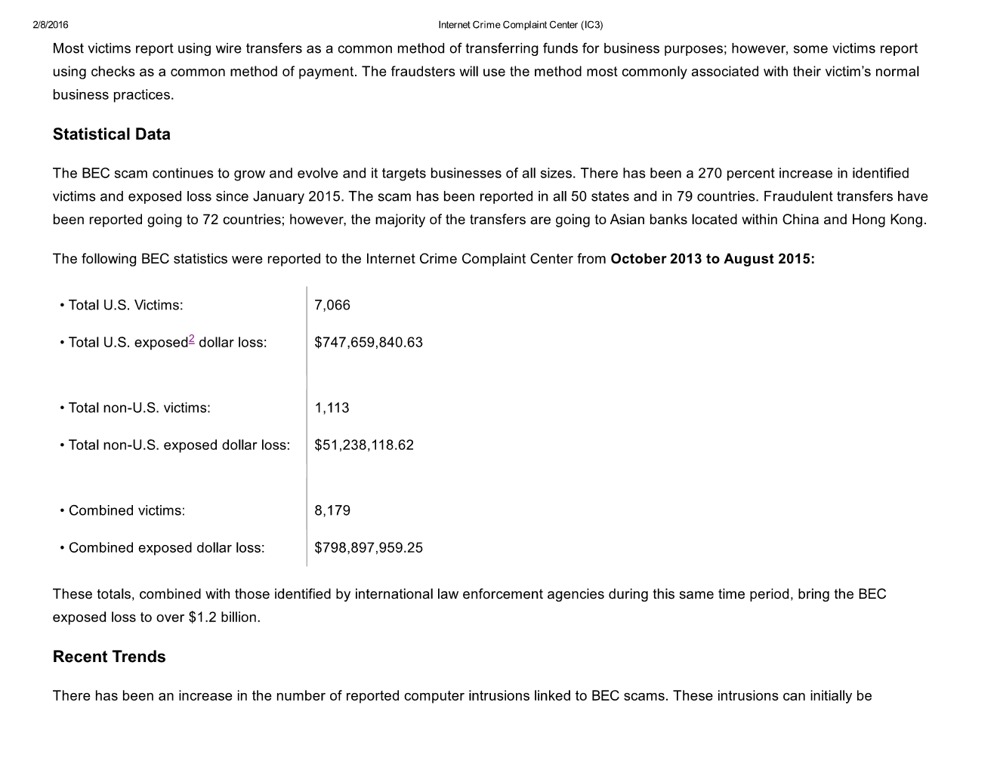
Fbi advisory

Slide 17
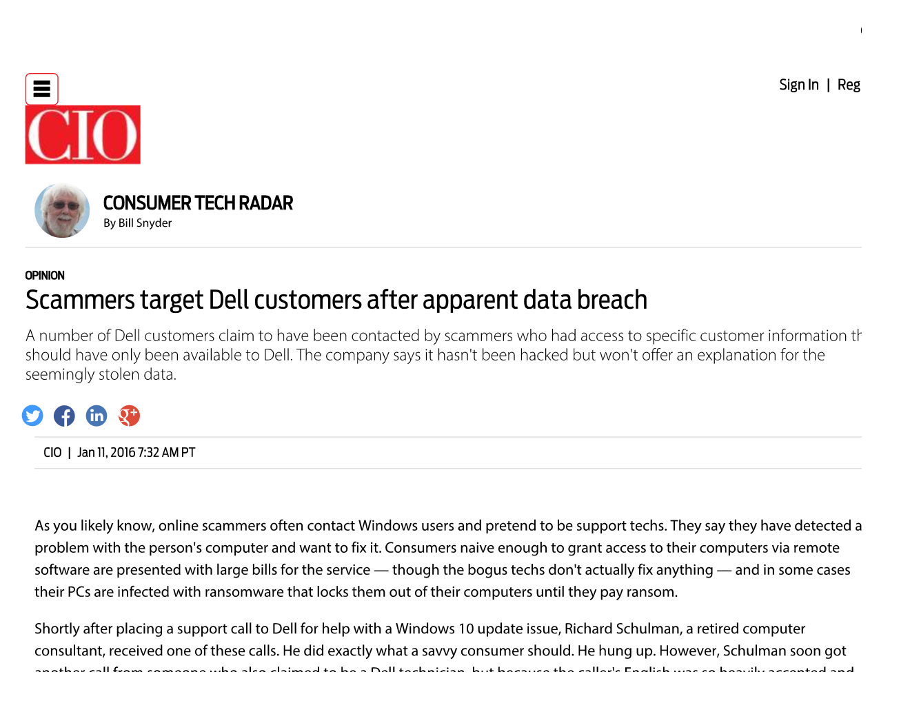
Dell Data Breach

Slide 18
Defense against social engineering
Be suspicious
Training
Don’t give out information
Be mindful before clicking a link
Don’t circumvent security protocols
Third Party Security Test
Make sure information is destroyed securely

Slide 19
Social Engineering Policies

Slide 20
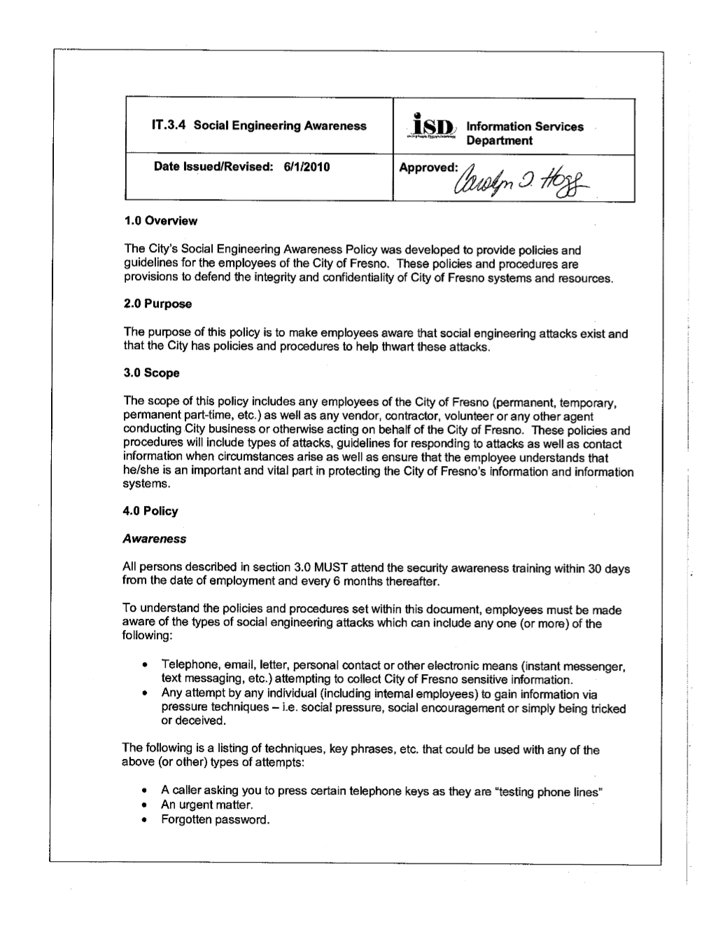
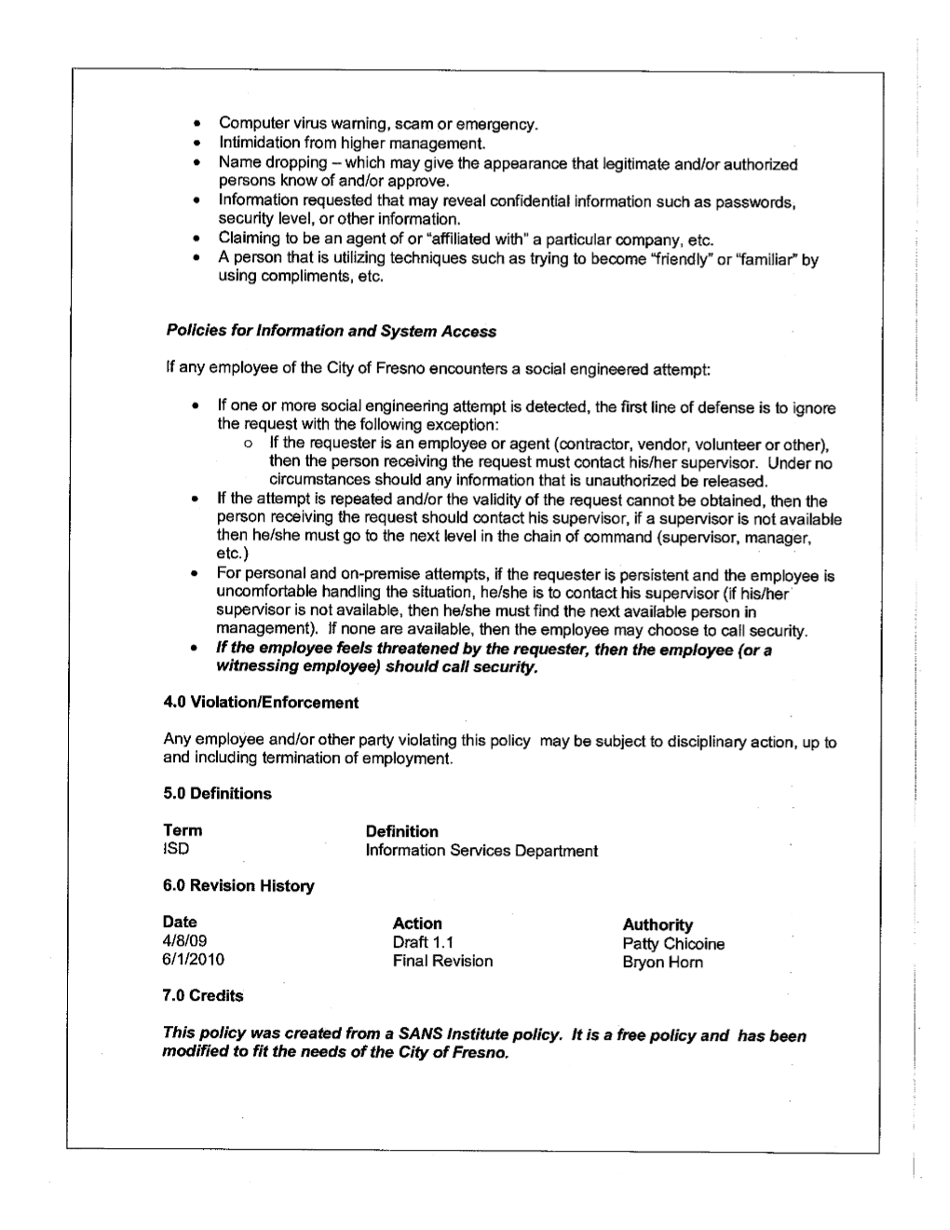

Slide 21
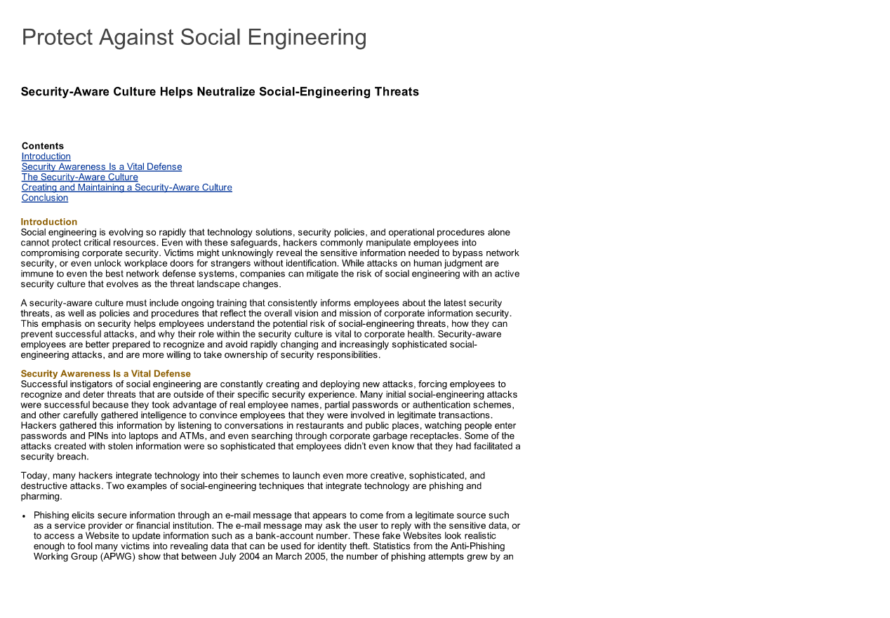
CISCO

Slide 22
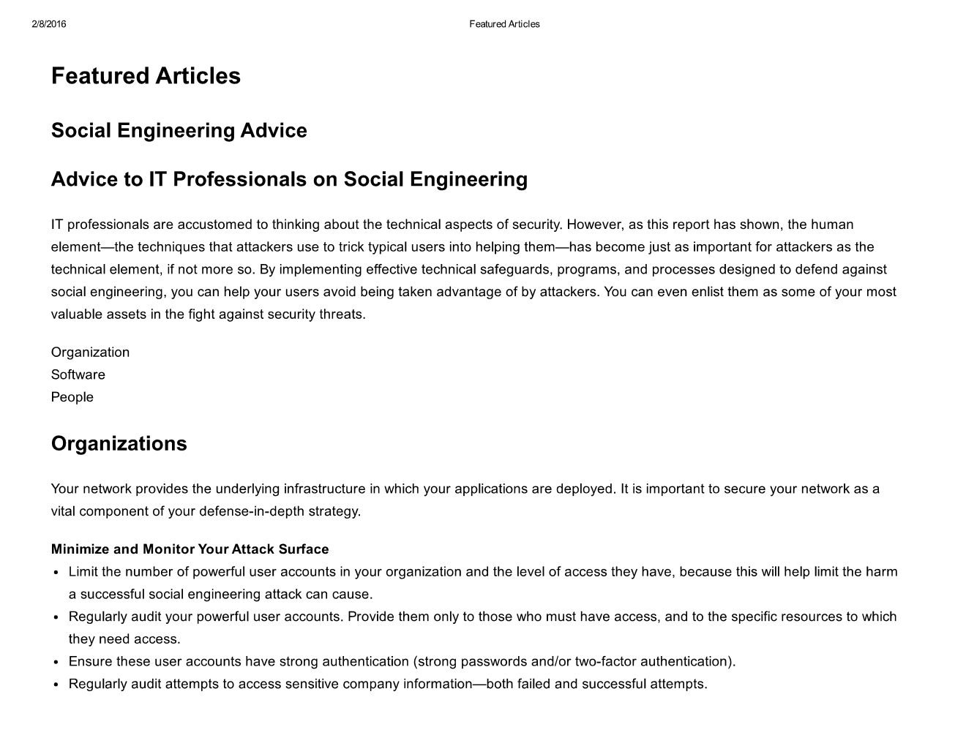
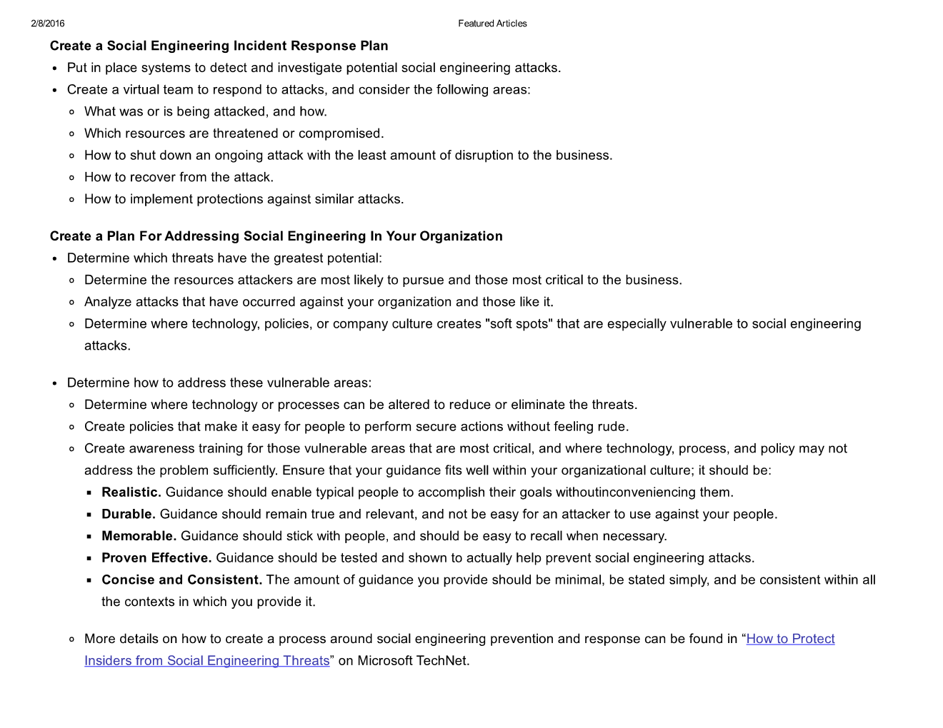
Microsoft security intelligence report

Slide 23
DEFCON - Android Pattern password
https://www.youtube.com/watch?v=6Z5NtzFA7Z8&index=11&list=PL9fPq3eQfaaB8-9l8mo9x_khCEkobzTDW

Slide 24
Questions?

